Slide 1
AC22005
Section 2 - Lecture 11
Input/Output Techniques

Slide 2
Outline of this topic
Now:
  Input/output - introduction
Thursday:
  1300: Input/output – techniques
  1600: more from Prof. Arnott*
Friday:
  Bus architectures*
  * these may swap over

Slide 3
Outline of today’s lecture
  Introduction to I/O
  Polling
  Advantages and disadvantages of polling
  Interrupt-driven I/O
  Advantages and disadvantages of interrupts

Slide 4

Thought for the Day

Slide 5
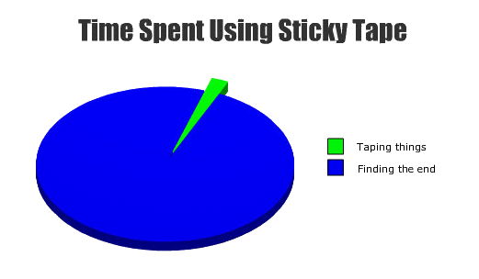
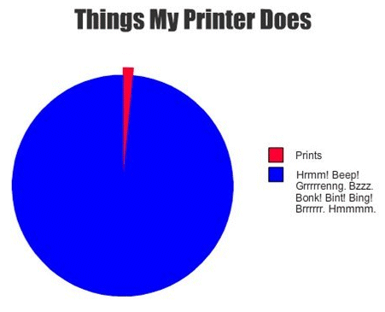
Graph of the Day

Slide 6
Introduction to I/O

Slide 7

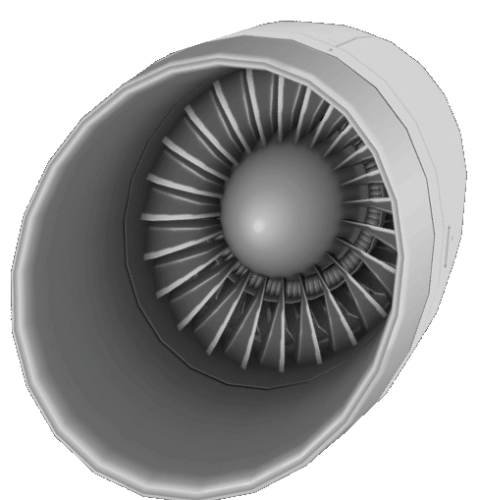
The Computer
DATA BUS
Micro-
processor
Memory
Input/
Output
ADDRESS BUS
CLOCK

Slide 8
The Computer
DATA BUS
Micro-
processor
Memory
Input/
Output
ADDRESS BUS
CLOCK

Slide 9
Input/Output
Input/output facilities allow the computer (and hence application programs) to interact with the world outside the box:
  receive data and instructions for programs
  allow output of processed results
There are many different I/O devices, and they are an essential part of any microcomputer.
We are mainly discussing the I/O chips within the computer, not the peripherals themselves (mouse, keyboard, VDU, disk drives etc.).

Slide 10
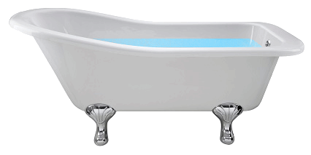
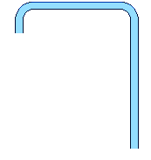


Fundamental Concepts
Input/output usually involves:
  copying a (large) block of memory to another block
  e.g. main memory to video device
  copying a (large) block of memory to one address, one chunk at a time
  e.g. image to a printer
  copying from one address to a (large) block of memory, one chunk at a time
  e.g. download file from network

Slide 11
Fundamental Concepts
Although the I/O chips “look the same” as memory to the CPU, they are attached to slow things (e.g. disk hardware, humans) so operation of I/O devices is V-E-R-Y S-L-O-W.
As CPU / memory speeds have increased dramatically, I/O speeds have increased comparatively slowly (if at all).
It is important that we design our system so that fast features are not penalised by slow I/O operations.

Slide 12


Slide 13
I/O Problems
Peripheral devices differ greatly in many aspects including:
  data rate
  unit of transfer
  data representation
  error conditions
Consequently, we can’t just attach them straight to the system bus - the I/O devices must interface between the computer and the outside world!

Slide 14
Interfacing I/O devices
Peripherals
Hard
Disk
Keyboard
Screen
Interface
I/O chip
I/O chip
I/O chip
System Bus
CPU
Memory
This is a very simple I/O scheme

Slide 15
Simple I/O Chip
Initialisation
Register:
Sets up the I/O
device
I/O Chip
Data Register:
Data read from, or to
be written to,
peripheral
Status Register:
Records whether data has been received
from peripheral
Records whether peripheral is ready to
receive data
May provide error information

Slide 16
Data transfer
The amount of data in most I/O transfers will be much bigger than the size of the data register on the interfacing I/O chip.
Hence, I/O transfer is done in “chunks” - each chunk is the size of the data register.
This causes a problem - CPU is much faster than most I/O transfers, so the I/O cannot receive or send data nearly as fast as the CPU. So, the CPU must be “synchronised” with the I/O device in some way.

Slide 17
Interfacing considerations
For output:
  the CPU should only place new data in the data register of the I/O chip when the I/O device has finished sending the previous data
For input:
  the CPU should only read data from the data register when new data has been completely (and error-free) received from the peripheral

Slide 18
Implementing I/O
There are three main ways in which I/O is performed:
  Polling (also known as “programmed I/O”)
  Interrupt-driven I/O
  Direct Memory Access (DMA)
We will examine each of these in detail.

Slide 19
Polling

Slide 20
Polling - inputting of data
Begin polling loop
Check Status Register to see
if peripheral has sent data
Sent
Not Sent
Read in data from
Data Register

Slide 21
Example of polling
Output to a slow printer whose data register can hold one ASCII character:
  we want to print the word “FILE” out on the printer

Slide 22
Polling example
FILE
Printer
Program in memory
CPU
I/O Chip
CPU checks
status register
CPU checks the printer’s status register.

Slide 23
Polling example
FILE
Printer
ready
Printer
Program in memory
CPU
I/O Chip
CPU finds that the printer is ready to receive a new character.

Slide 24
Polling example
FILE
Printer
Program in memory
CPU
I/O Chip
F
“F” transferred
Letter “F” copied from memory to the data register.

Slide 25
Polling example
FILE
Printer
Program in memory
CPU
I/O Chip
F
CPU checks
status register
CPU starts polling to check the I/O chip’s Status Register.

Slide 26
Polling example
FILE
Printer
NOT ready
Printer
Program in memory
CPU
I/O Chip
F
CPU finds I/O chip is NOT ready to receive a new character.

Slide 27
Polling example
FILE
Printer
Program in memory
CPU
I/O Chip
F
CPU checks
status register
CPU checks the I/O chip’s Status Register again.

Slide 28
Polling example
FILE
Printer
NOT ready
Printer
Program in memory
CPU
I/O Chip
F
CPU finds I/O chip is NOT ready to receive a new character.

Slide 29
Polling example
FILE
Printer
Program in memory
CPU
I/O Chip
F
CPU checks
status register
CPU checks the I/O chip’s Status Register again.

Slide 30
Polling example
FILE
Printer
NOT ready
Printer
Program in memory
CPU
I/O Chip
F
CPU finds I/O chip is NOT ready to receive a new character.

Slide 31
Polling example
F
FILE
Printer
Program in memory
CPU
I/O Chip
F
CPU checks
status register
CPU checks the I/O chip’s Status Register again.

Slide 32
Polling example
F
FILE
Printer
ready
Printer
Program in memory
CPU
I/O Chip
F
CPU finds I/O chip IS ready to receive a new character.

Slide 33
Polling example
F
FILE
Printer
Program in memory
CPU
I/O Chip
I
“I” transferred
Letter “I” copied from memory to the data register.

Slide 34
Polling example
The CPU would then enter another polling loop to wait until the printer had printed out the character “I”.
The CPU would carry on in this way until the entire word “FILE” had been printed out.

Slide 35
Problems with polling
If the CPU wanted to (for example) output to disk, or input from the keyboard at the same time as printing, it could miss some events while checking for others.
Polling can thus cause problems where multiple I/O channels are available (though buffering the channels can alleviate this).

Slide 36
Polling
Advantages:
  simple, easy to implement
  easy to debug
Disadvantages:
  very wasteful of CPU time
  possible problems with multiple events
So, polling is simple to do, but is not suitable for “serious” I/O applications.

Slide 37
Interrupts

Slide 38
Interrupt-Driven I/O
An interrupt is a suspension of a process caused by an event outside the process.
The suspension is performed in such a way that the process can be resumed at a later time.

Slide 39
Using Interrupts
The CPU issues an I/O command, then continues executing other instructions (perhaps from a different process).
Later, when the I/O device requires servicing, or becomes ready again, it “interrupts” the CPU to ask for further processing.
The code sequence for processing each interrupt is in a special subroutine called an interrupt handler or an interrupt service routine, accessed via a stored address list.

Slide 40
Interrupts example
Keyboard
Interrupts list
Keyboard Handler
Memory
CPU
Keyboard Buffer
I/O Chip
Program
Processor busy executing code.

Slide 41
Interrupts example
Keyboard
Interrupts list
Keyboard Handler
Memory
CPU
Key has
been pressed
Keyboard Buffer
I/O Chip
Program
Keyboard pressed, so slave creates interrupt - processor stops executing the program and jumps to interrupt list.

Slide 42
Interrupts example
Keyboard
Interrupts list
Keyboard Handler
Memory
CPU
Keyboard Buffer
I/O Chip
Program
Interrupt list gives the address of the handler for this interrupt, and calls the keyboard handler.

Slide 43
Interrupts example
Keyboard
Interrupts list
Keyboard Handler
Memory
CPU
Keyboard Buffer
I/O Chip
Get key data
Program
CPU executes keyboard handler code, which accesses data register of I/O chip and reads in the key-press.

Slide 44
Interrupts example
Keyboard
Interrupts list
Keyboard Handler
Memory
CPU
Keyboard Buffer
I/O Chip
Store key data
Program
Keyboard handler will store the key-press in an input buffer
somewhere in memory.

Slide 45
Interrupts example
Keyboard
Interrupts list
Keyboard Handler
Memory
CPU
Keyboard Buffer
I/O Chip
Program
Interrupt has been handled - CPU resumes executing the
original program where it left off.

Slide 46
Multiple interrupts
If we have several I/O devices active, each can create a unique interrupt request, to be processed in the same way.
We can also have multi-level interrupts, so that low priority interrupts (e.g. keyboard) can themselves be interrupted by higher priority interrupts (e.g. disk drive).
PROCESS
Disk access
Key press
Program
TIME

Slide 47
Interrupt-driven I/O
Advantages:
  more efficient than polling - avoids the CPU having to repeatedly loop to test the status register of the device
  powerful way of handling multiple I/O devices - can have multi-level interrupts

Slide 48
Interrupt-driven I/O
Disadvantages:
  overhead in handling the interrupts: need to save and restore process contexts - this may take longer than interrupt itself!
  hardware needed to support interrupts e.g. inclusion of interrupt lines on buses
  difficult to debug interrupt scheme
  still requires the active intervention of the CPU to transfer data

Slide 49
Summary
We have seen:
  any microcomputer requires I/O facilities
  polling is easy, but not very efficient / practical
  interrupts are more complex, but efficient and allow sophisticated I/O schemes
Next meetings:
  Tomorrow at 12noon - C# marking in lab
  Thursday at 1pm - more on I/O techniques

